Slide 1
Watershed Considerations Oldman River Basin
Presentation to MD of Pincher Creek Council
Dec. 8, 2020

Slide 2
AGENDA
Water Policy Framework
State of the Oldman River Watershed
Current Mechanisms to Access Water
Risks of Changing Water Allocation Order
2

Slide 3
*Water Policy Direction – Closed Basins
Limits for water allocations reached or exceeded (August 2006)
Closed Bow, Oldman, South Saskatchewan River subbasins to:
Recover and conserve aquatic environment
Reduce risk to existing licence holders
Ensure Alberta meets obligations to downstream neighbours
Address knowledge gaps through monitoring, research
*Water Allocation Policy for Closed River Basins in the South Saskatchewan River Basin Directive: Reviewed Sept. 22, 2016
3

Slide 4
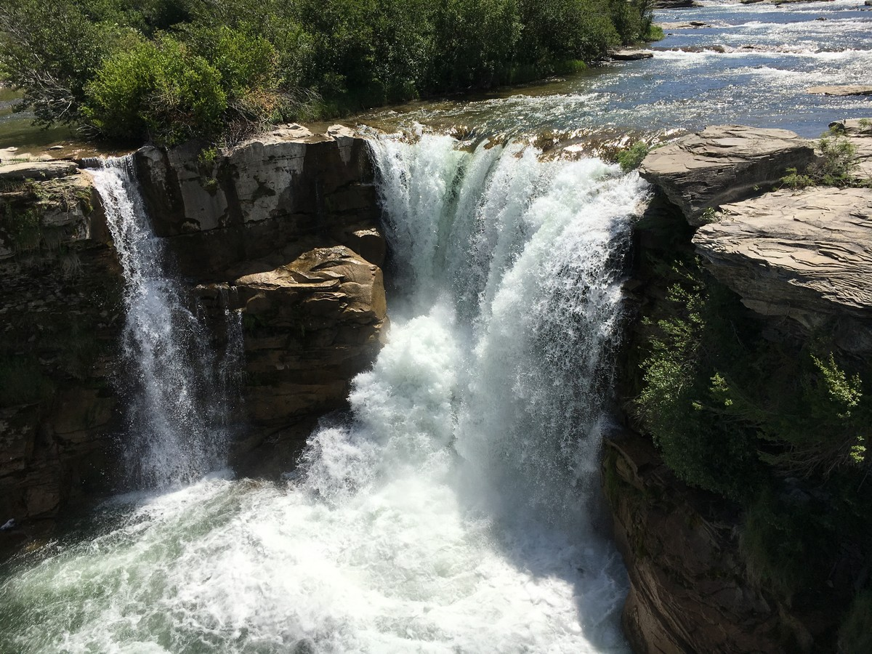
Characteristics of the Watershed
Highly variable water flows
Climate change impacts
Region susceptible to drought
Mountain sub-basins critical
High frequency of deficits to lower priority users
Water conservation objectives often unmet
4

Slide 5
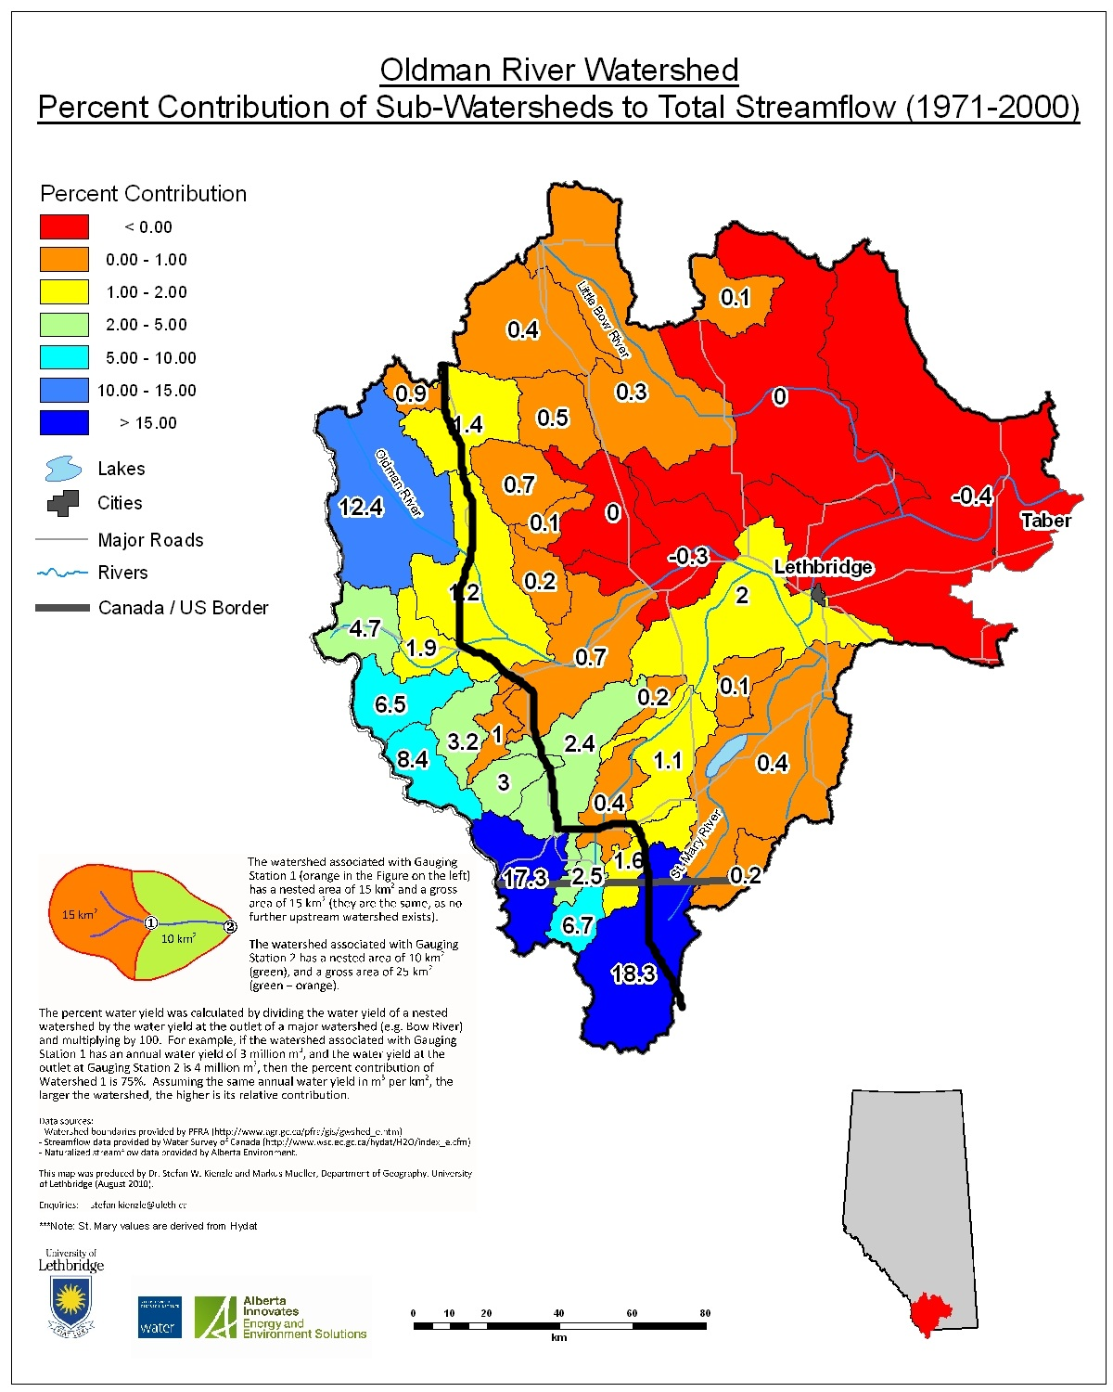
Approximately 90% of the water in the Oldman River comes from the headwaters
From Dr. Stefan Kienzle at the University of Lethbridge
5

Slide 6
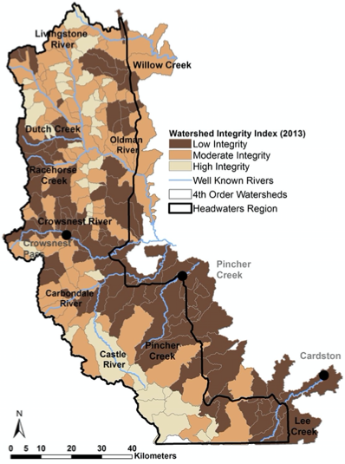
Watershed Integrity Index
95% of headwaters have low to moderate integrity
From OWC Headwaters Indicators Project 2014
Notes:
Headwaters are facing pressure from cumulative effects.
Watershed integrity has already declined across 95% of the headwaters.
Grassy Mountain Coal Project would add another type of land use in an already crowded landscape and put additional pressure on ecosystem services.

Slide 7
Watershed Health Depends on Mountain Sub-basins
*
*South Saskatchewan River Basin in Alberta Water Supply Study 2010
Livingstone Landowners Group - December 8, 2020

Slide 8
Water Availability
Closed except for legislated exceptions
Water market, through licence transfers
Legislated Exceptions for Crown Reserve (BOSS Allocation)
First Nations projects
Water Conservation projects
Storage projects to protect the aquatic environment & existing licence holders
Applications complete when the order was filed in 2007
Oldman River Basin Water Allocation Order

Slide 9
Oldman River Allocation Order
Applies to withdrawals directly from headwaters area (region upstream of the Oldman River Dam (MD of Pincher Creek, MD of Ranchland, Municipality of Crowsnest Pass)
Up to 11,000 acre-feet of water available for defined users:
 | Reserved Total | Licensed/applied for | Unallocated
Non-industrial (municipal, recreation, rural communities, commercial agriculture – non-irrigation) | 1,500 | 326 | 1,174
Industrial | 150 | 150 | 0
Irrigation | 9350 | 1,295 | 8,055
Total | 11,000 acre-feet | 1,771 acre-feet | 9,229 acre-feet

Slide 10
Proposed Government Rule Change
Eliminate categories of users
Set one overall limit, including industrial
Set aside 20% for environmental support
Provides coal companies access to new water licences at little or no cost
Reduces reserve for future needs of other users

Slide 11
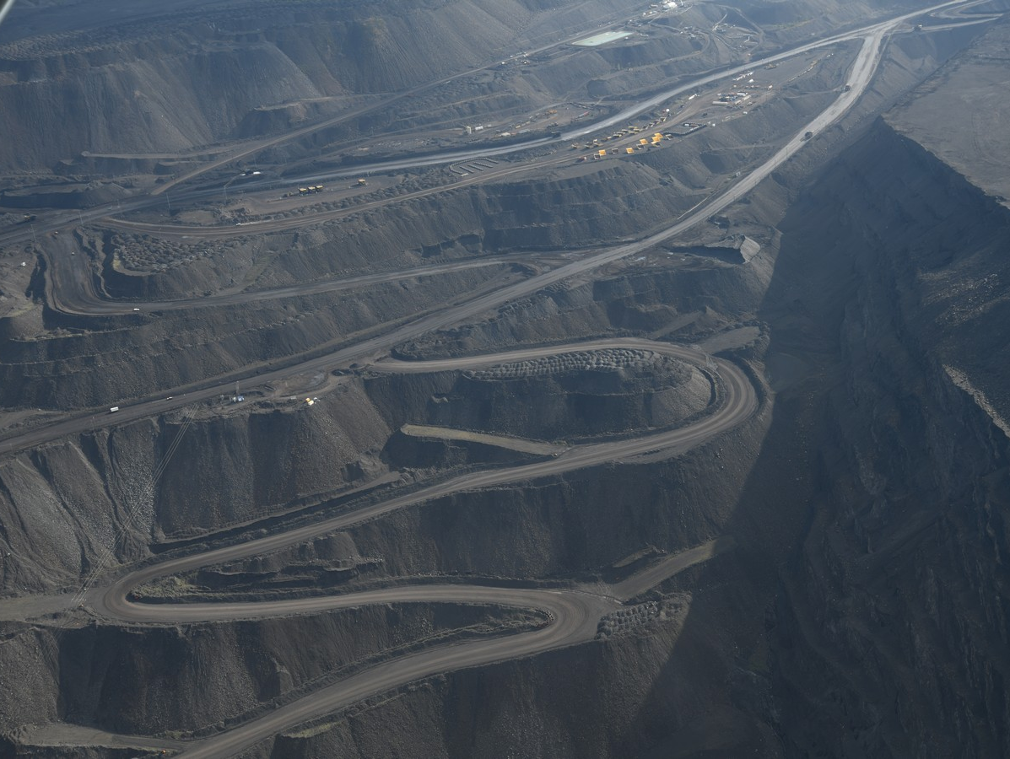
Risks of New Approach
Permanent damage to headwaters
Intense pressure on water source
Serious pollution risks
Threatens drinking water, aquatic ecosystems, sustainable growth
Notes:
Facilitates mountain-top removal coal-mining
Permanent damage to critical mountain headwaters region
Intensifies pressure on small tributaries and source waters
Serious pollution risks (selenium, arsenic and other dangerous elements)
Increases risks to downstream users (loss of water quantity and quality)
Threatens riparian areas and already endangered aquatic life

Slide 12
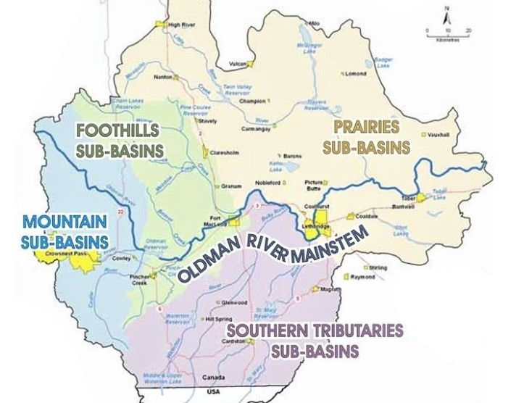
Mountain Sub-Basins
High basin yield
Few water licences
Frequent WCO deficits
Good water quality

Slide 13
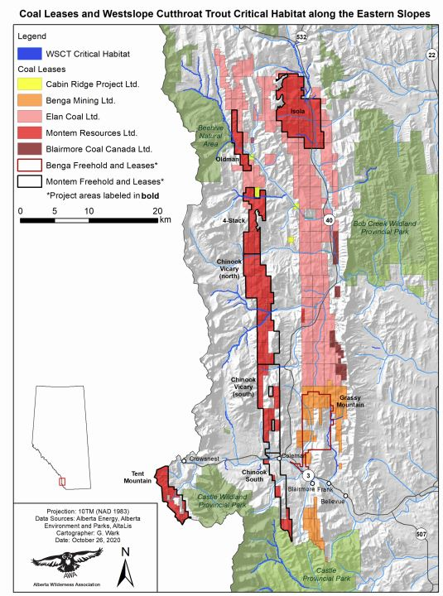
Proposed Coal Mines
More than 800 sq km of approved coal leases
Located in headwaters
Intense water users
Known source of pollutants
Excavate the water tables
Disrupt & destroy streams, springs, wetlands

Slide 14
Important Considerations
Location in the mountain sub-basins is a major issue
Existing water policies have NOT achieved objectives
Still lack key data on stream flows and water quality
Coal mining impact extreme and irreversible
14

Slide 15
Questions?
15

Slide 16
Background Information

Slide 17
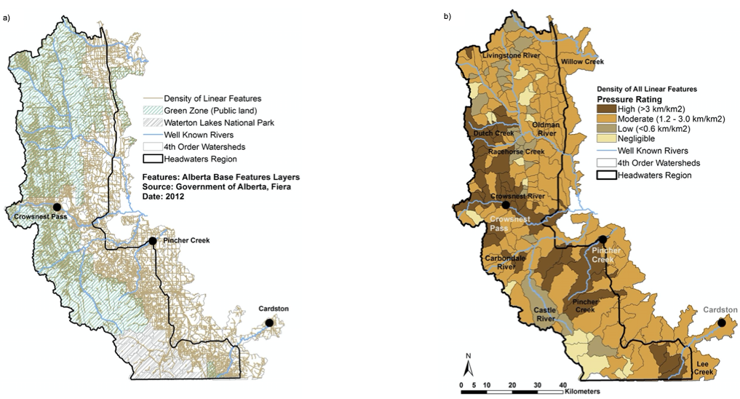
Linear features
From OWC Headwaters Indicators Project 2014

Slide 18
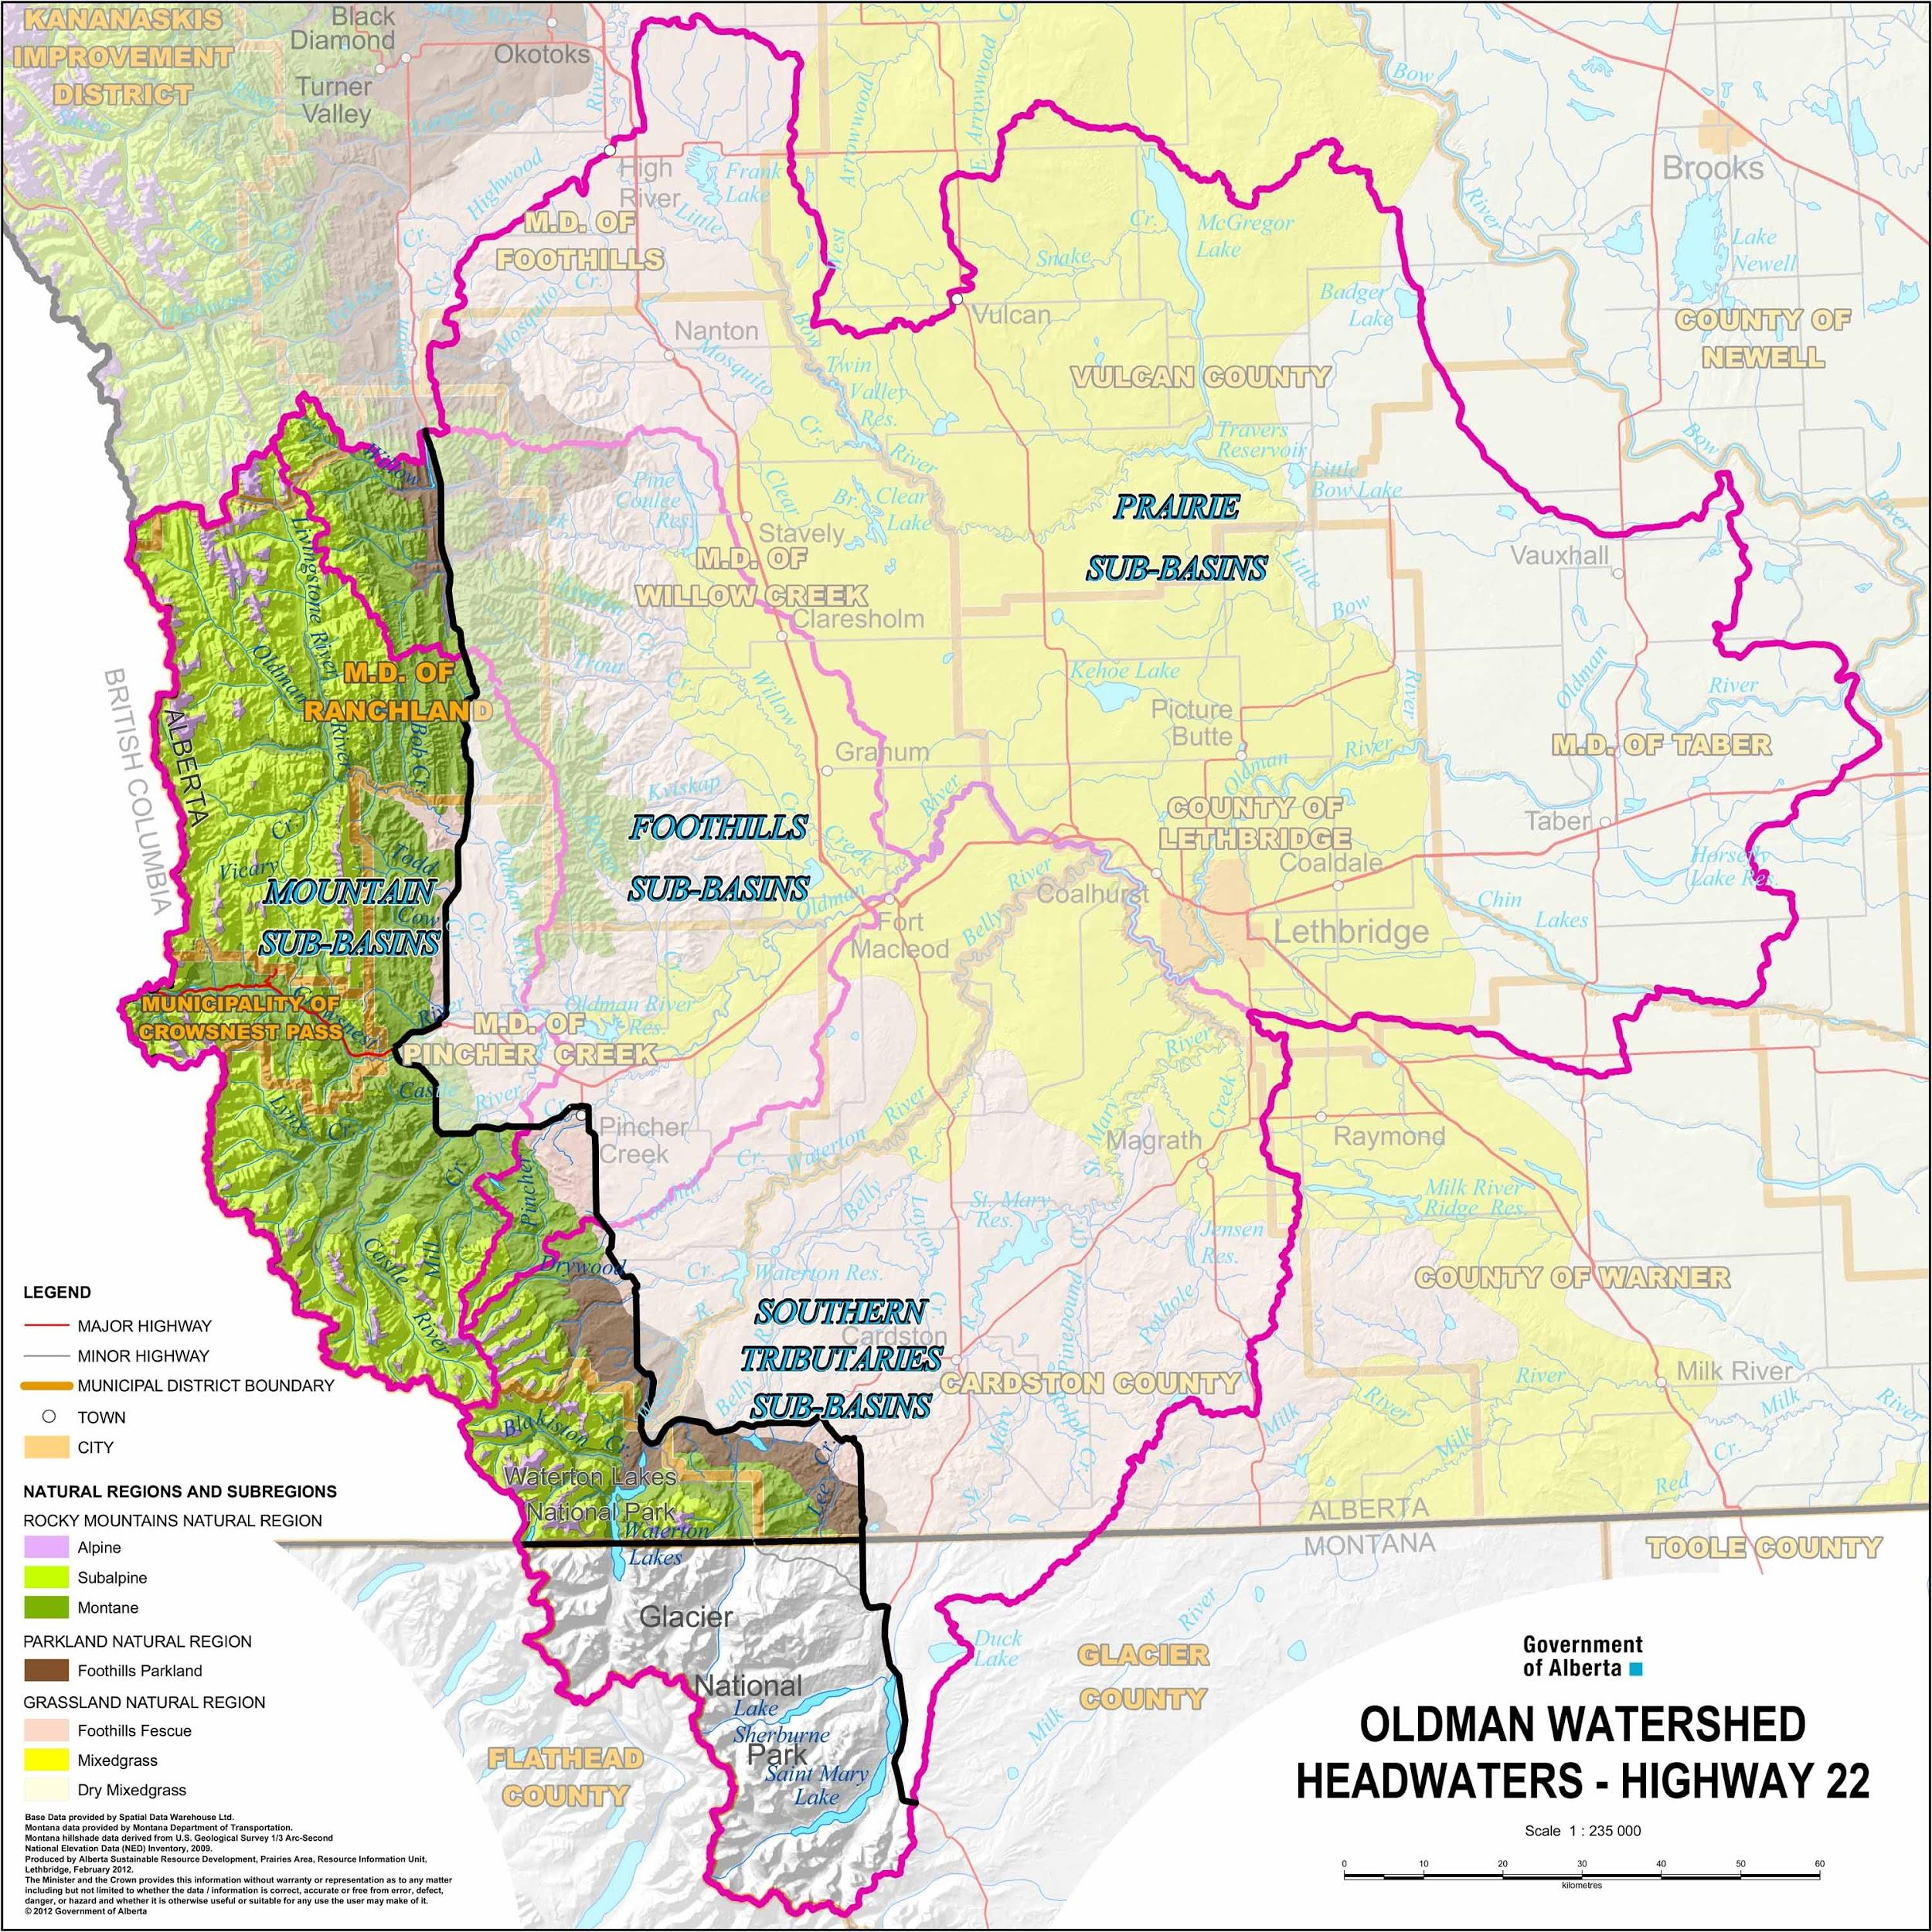
The Oldman headwaters - the rocky mountains
Map created by the Government of Alberta

Slide 19
Water Basin Closure Themes
Limits for water allocations reached or exceeded (2006)
Increasing demands for water creating supply risks
Poor and declining health of the aquatic environment
Knowledge gaps re: impact of changes to water flows

Slide 20
Water Policy Framework
SSRB Water Management Plan approved 2006
Bow, Oldman, SSRB Allocation Order (2007)
Oldman River Basin Water Allocation Order (2003, amended 2010)
Water Supply Study (2010)
Water Allocation Policy Directive For Closed River Basins (2016)
Implementation Review SSRB Water Management Plan (2018)
3

